Slide 1



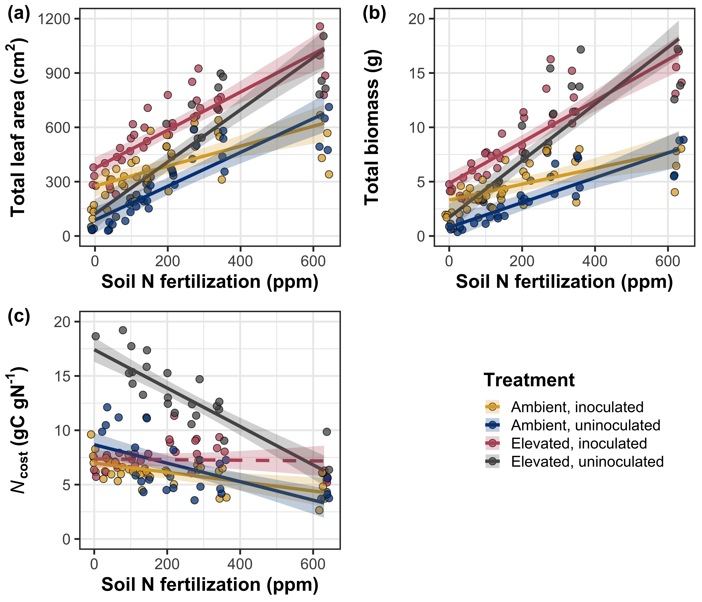
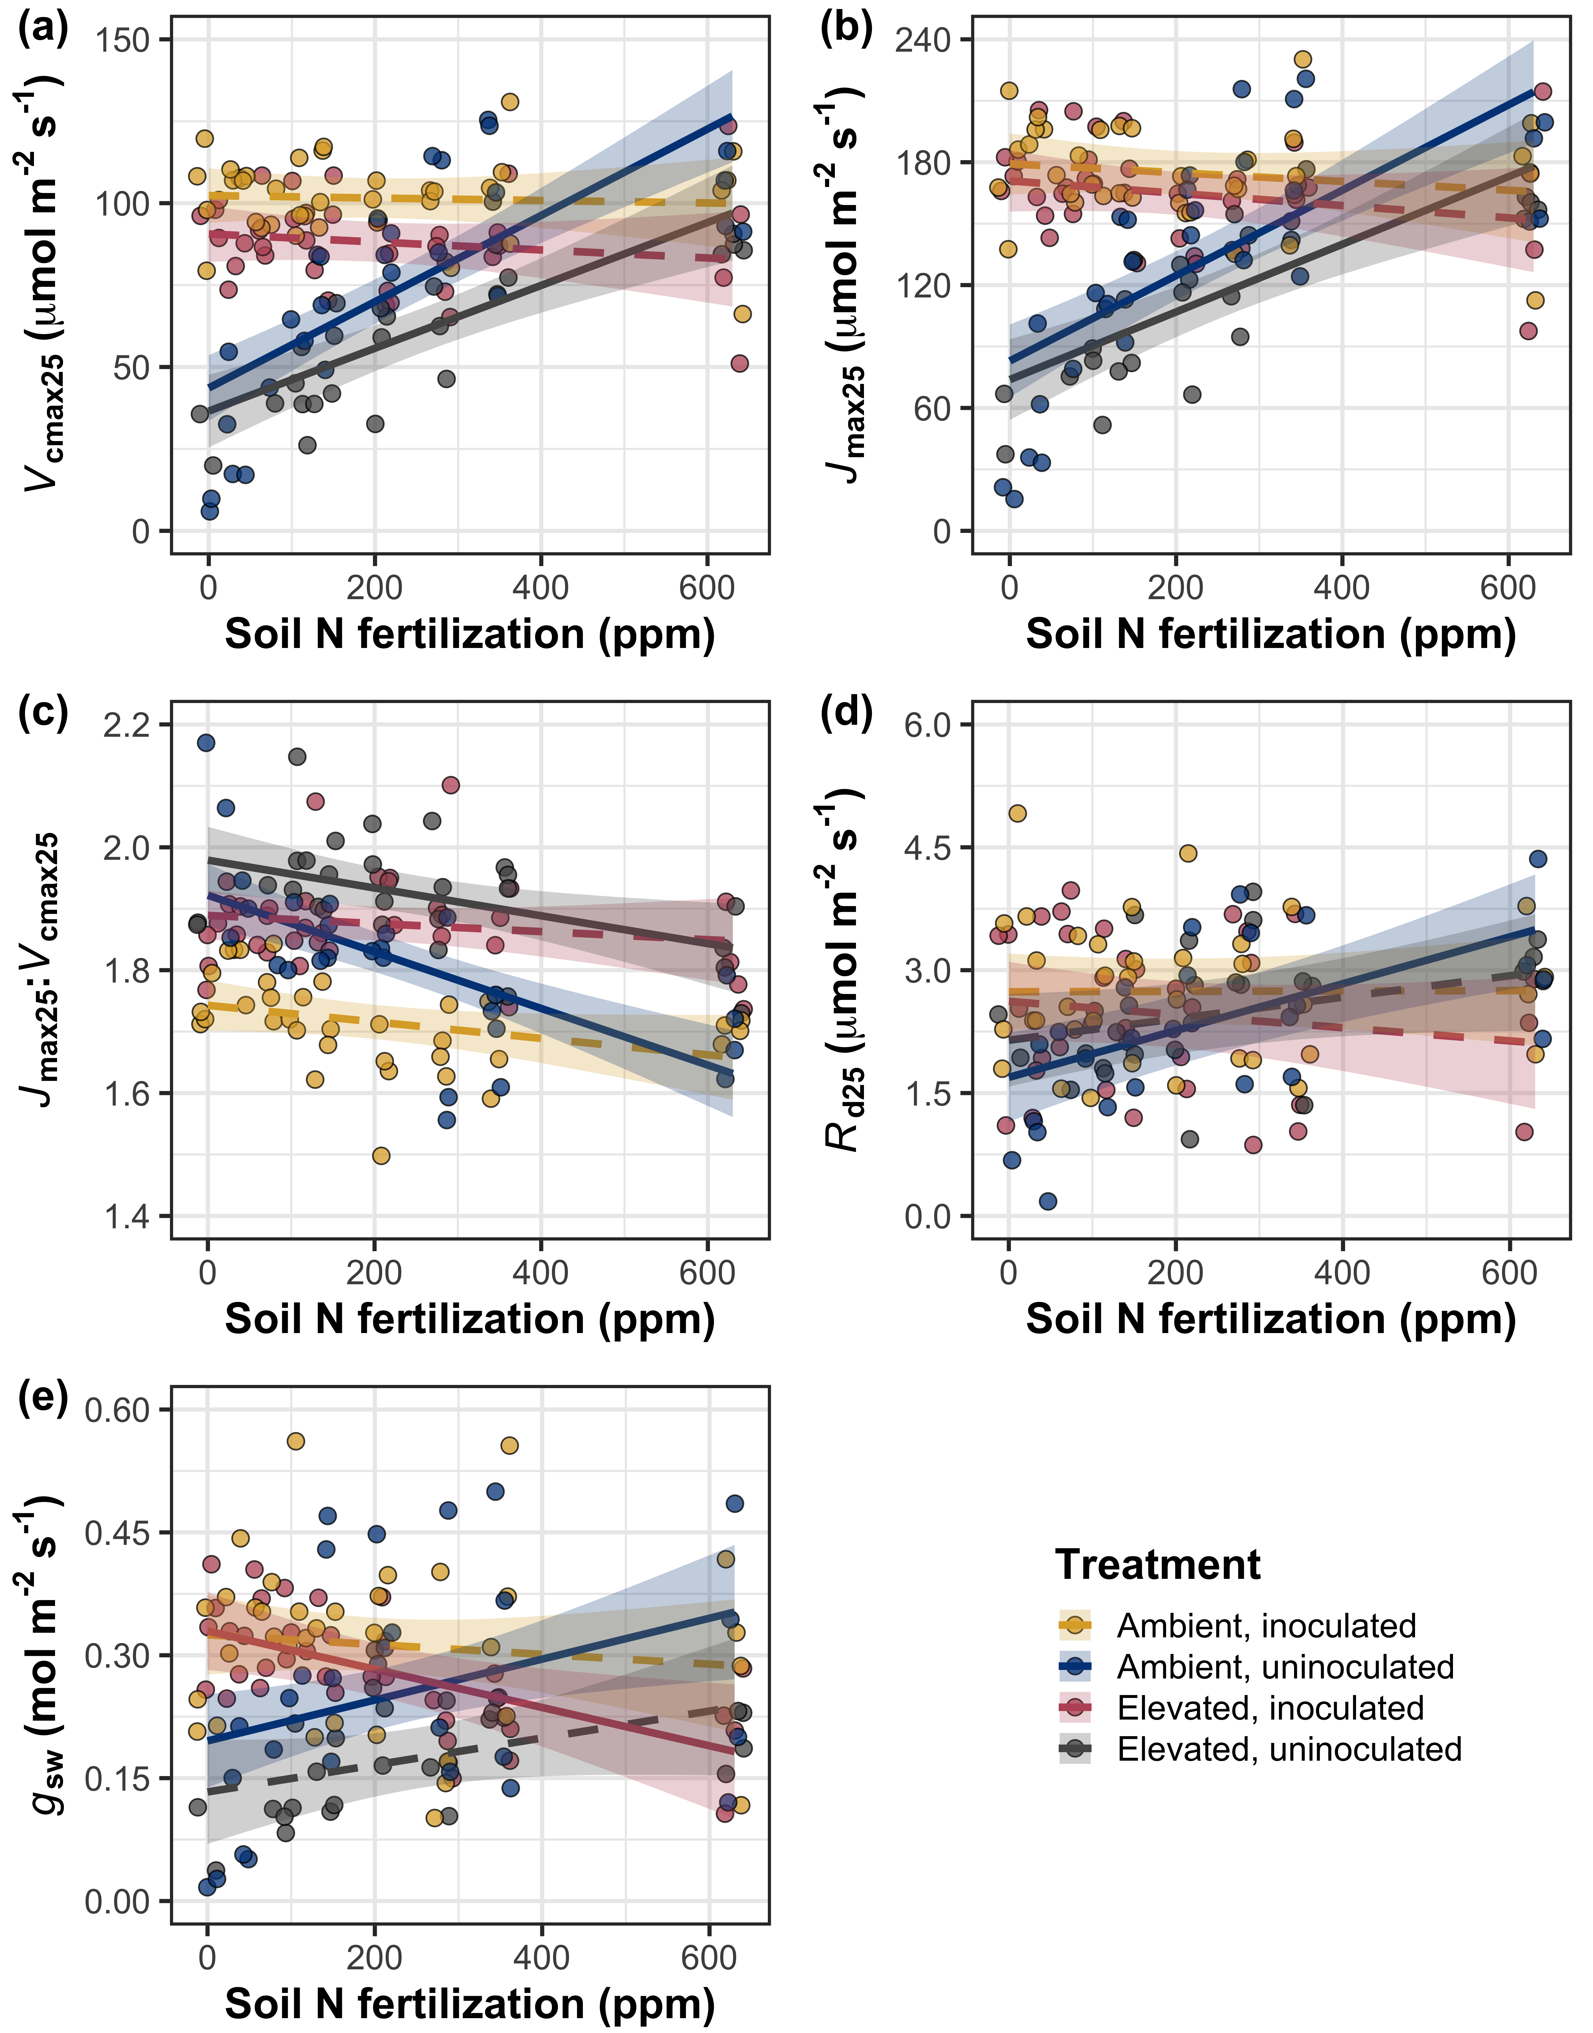
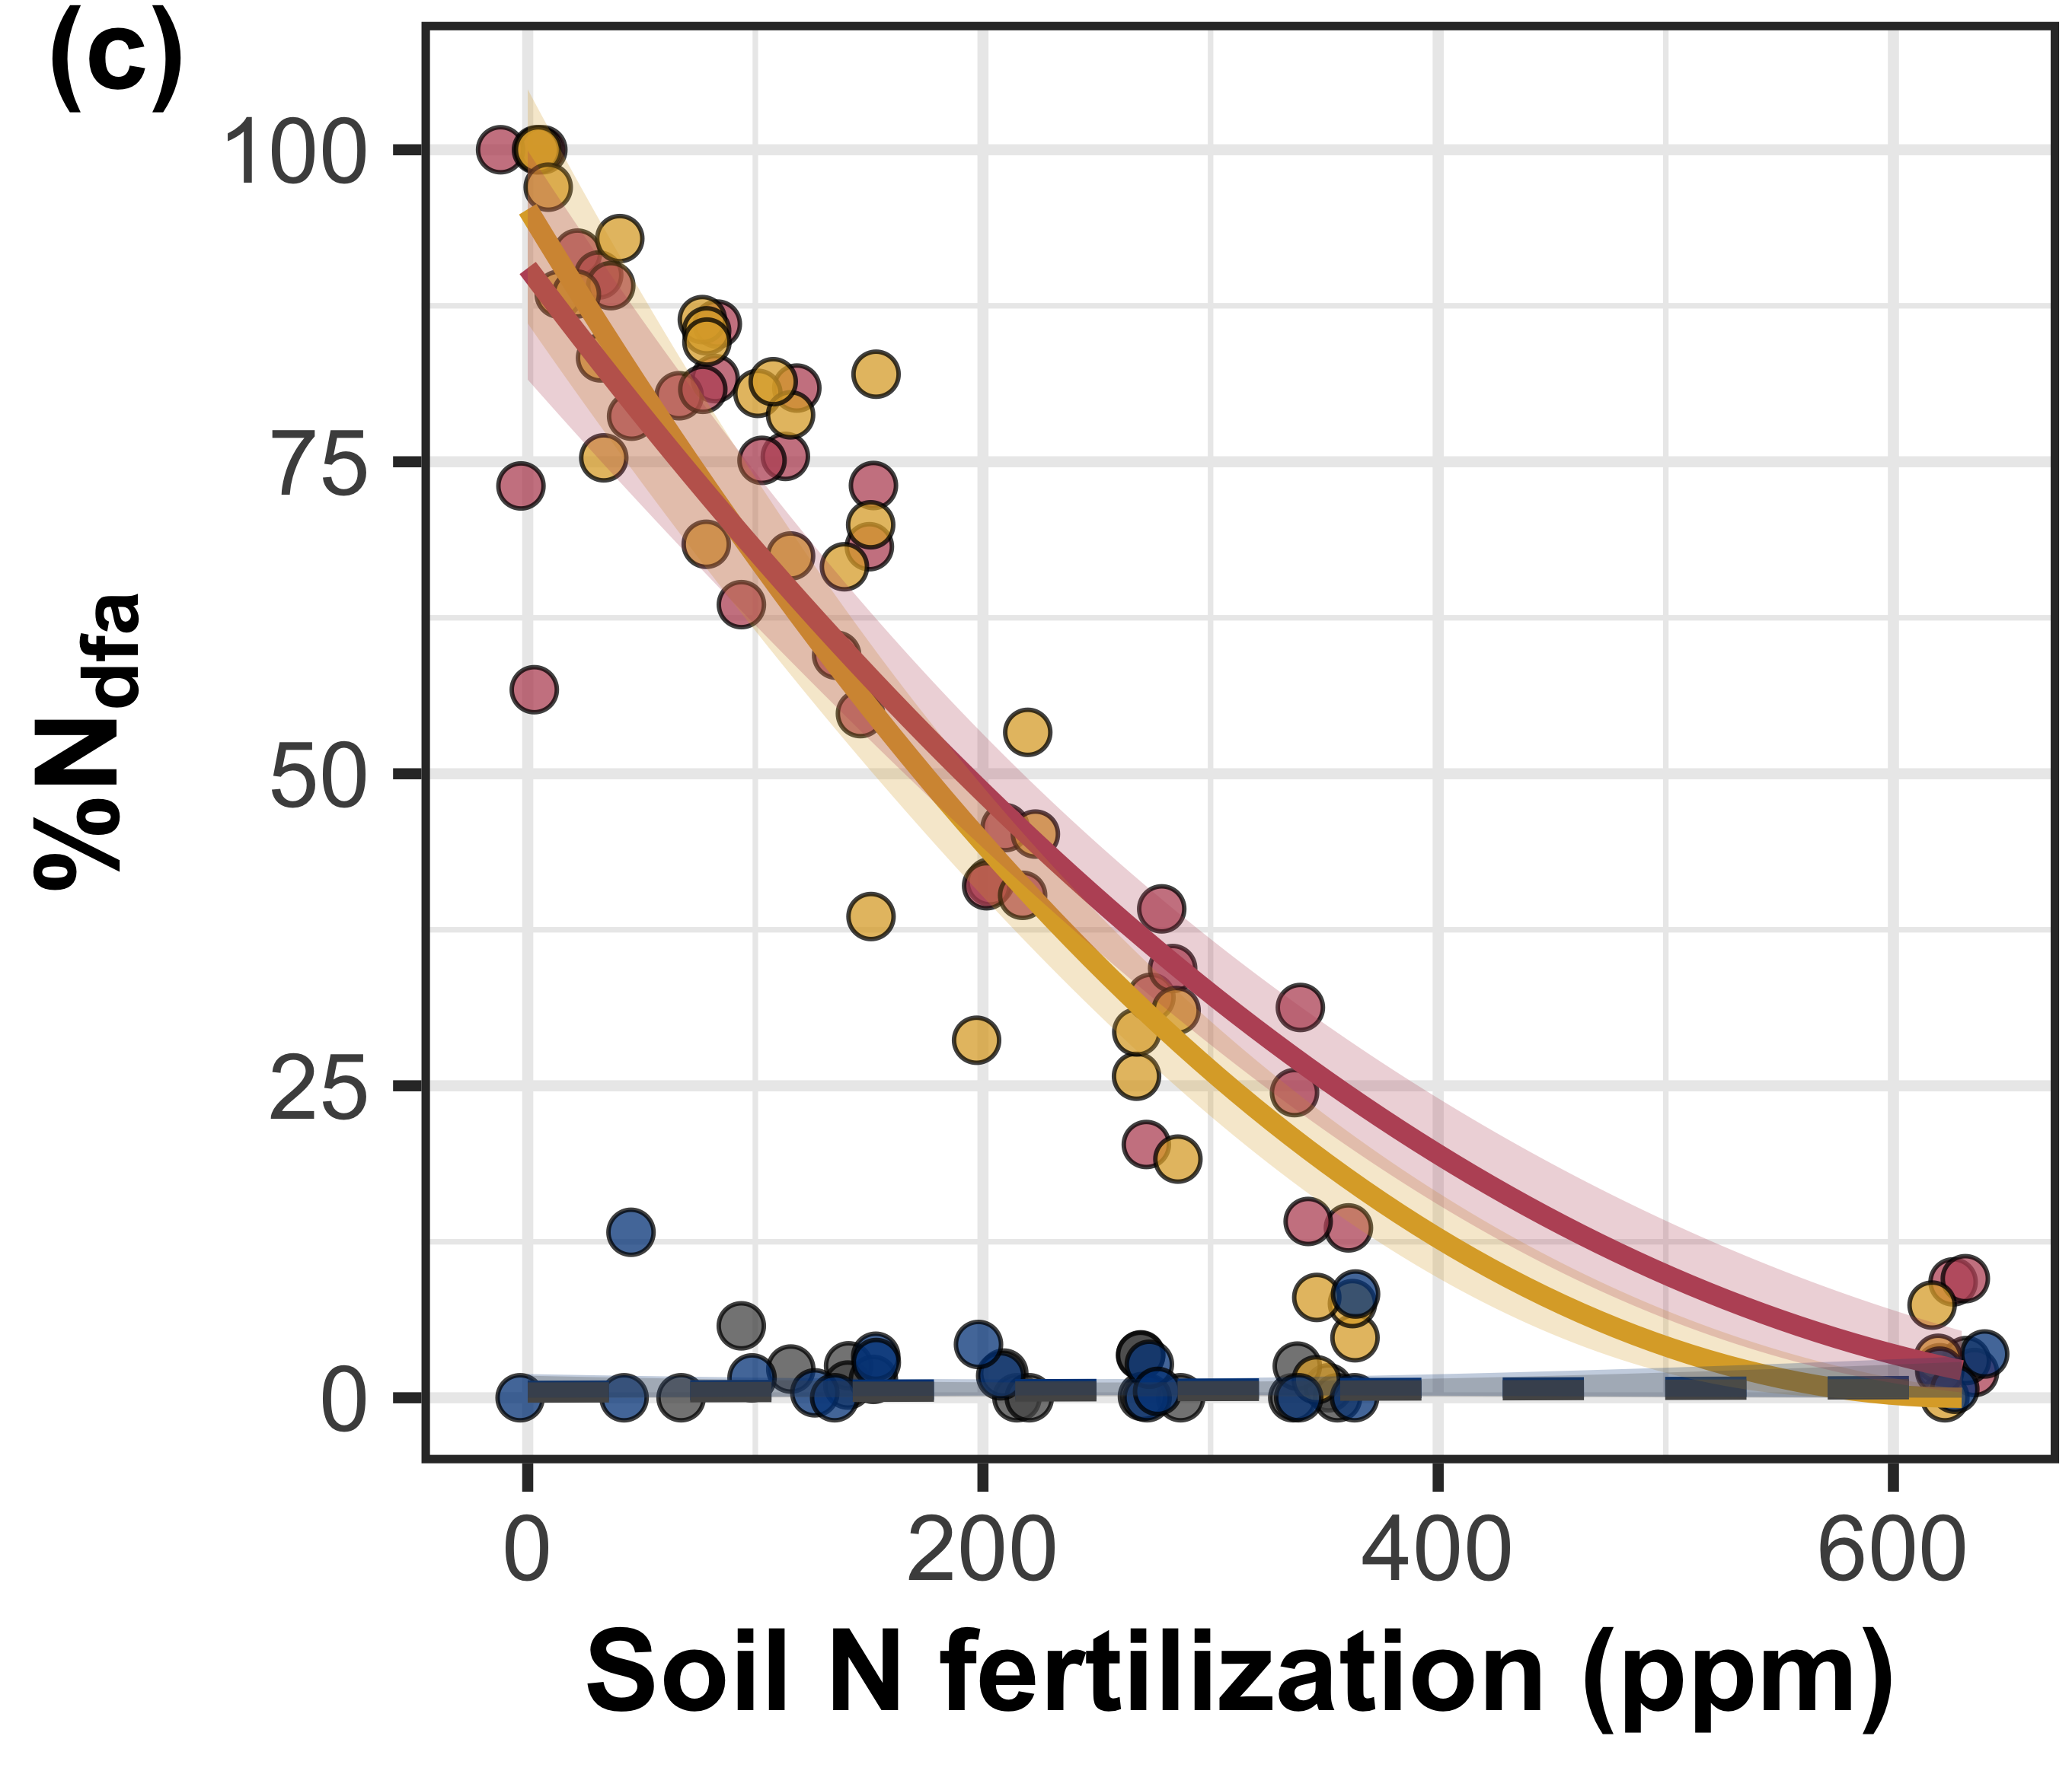
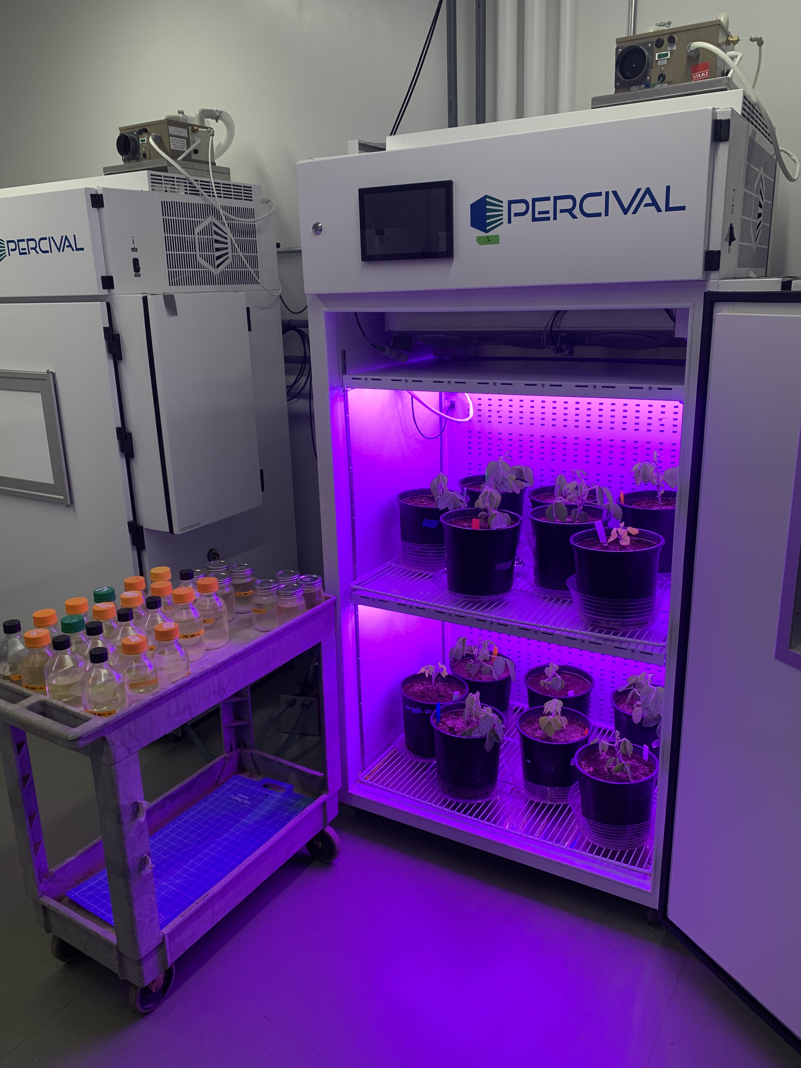
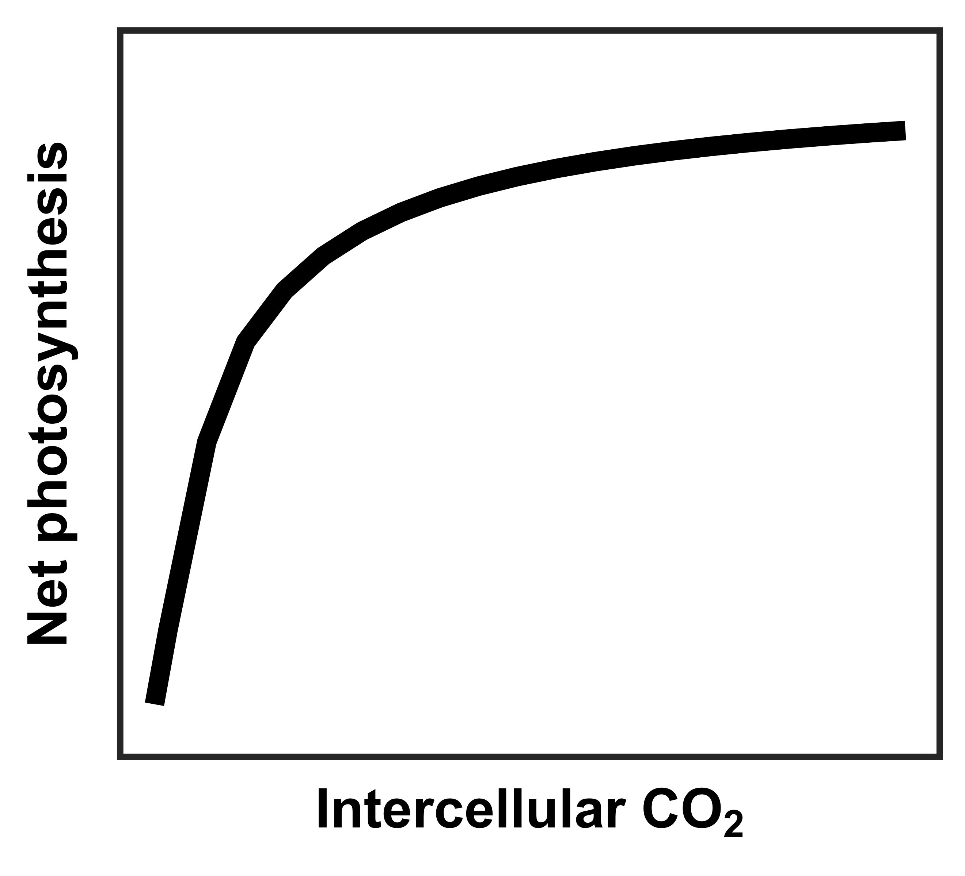
Leaf acclimation to elevated CO₂ is independent of soil nitrogen fertilization and rhizobial inoculation
Elevated CO₂ reduced photosynthetic process rates independent of fertilization…
Elevated CO₂ increased carbon
cost of acquiring N, while
increasing fertilization decreased
carbon cost of acquiring N
Evan A. Perkowski¹, Ezinwanne Ezekannagha¹, Nicholas G. Smith¹
¹Department of Biological Sciences, Texas Tech University, Lubbock, Texas, USA
evan.a.perkowski@ttu.edu
@EvanPerkowski
eCO₂: belowground C allocation increases more than whole plant N uptake
INTRODUCTION
Plants reduce stomatal conductance and photosynthetic process rates in response to elevated CO₂ (eCO₂)
Progressive nitrogen (N) limitation – leaf responses to eCO₂ are a function of progressive declines in soil N availability due to positive relationships between soil N, leaf N, and photosynthetic capacity
Optimal coordination theory – leaf responses to eCO₂ are independent of soil N availability, are instead driven by optimal resource investment to photosynthetic capacity
We grew Glycine max L. (Merr) under two CO₂ treatments across nine fertilization levels in a full-factorial growth chamber experiment
Fertilization: whole plant N uptake increases more than belowground C allocation
Increasing fertilization reduced investment in symbiotic N fixation similarly between CO₂ treatments
METHODS
1
… while increasing fertilization increased the positive effect of elevated CO₂ on whole plant growth
Species
(Glycine max)
2
CO₂ concentrations
(420 ppm, 1000 ppm)
2
Inoculation treatments (B. japonicum)
9
N fertilization treatments
(0-630 ppm N)
DISCUSSION AND CONCLUSIONS
Leaf responses to CO₂ follow patterns expected from optimal coordination theory
Reductions in V_{cmax25} and J_{max25} under eCO₂ were independent of fertilization or inoculation
V_{cmax25} experienced stronger reductions under eCO₂ than J_{max25}, allowing net photosynthesis rates to approach becoming equally co-limited by Rubisco carboxylation and RuBP regeneration
Whole plant responses to CO₂ are supportive of patterns expected from progressive nitrogen limitation
Increased whole plant growth under eCO₂ was enhanced under increasing fertilization and in inoculated pots (but only under low fertilization)
Elevated CO₂ increased whole plant N uptake despite stronger increases in belowground C allocation
MEASUREMENTS AND CALCULATIONS
CO₂ response curves to estimate V_{cmax25} and J_{max25}
Total leaf area
Total biomass (dry biomass sum of all organs)
Carbon cost of nitrogen acquisition (belowground C per unit whole plant N uptake)
% N fixed from the atmosphere
V_{cmax25} = maximum Rubisco carboxylation rate
J_{max25} = maximum RuBP regeneration rate

